Slide 1
SPL-1 Midterm Presentation
Note Manager &
Extractive Summarizer
Offline Note Management and Extractive Summarization
Submitted by:
Supervisor:
Abrar Hossain Shahariar
Dr. Sumon Ahmed
Roll: 1716
IIT, University of Dhaka
Notes:
Note Manager & Extractive Summarizer
Organize your notes. Find information faster. Extract the key points effortlessly.
Software Project Lab 1
Submitted by:
Abrar Hossain Shahariar
Roll: 1716
Supervisor:
Dr. Sumon Ahmed
IIT, University of Dhaka

Slide 2
Project Overview
Problem
Project Scope
Notes scattered across .txt and .md files.
Fast, unified search across all notes.
Long notes are tedious & slow to review.
Automatic summaries without external AI service.
Existing apps are heavily cloud-dependent.
Fully offline, so notes stay private.
Existing apps are heavy, GUI-based.
Lightweight, fast terminal tool.
Notes:
Overview
Problem Statement
Notes are scattered across many .txt / .md files
Searching is usually very slow
Long notes are slow to review
Existing apps are heavy, GUI-based, and cloud-dependent
Motivation
Fast search across all notes
Automatic summaries, no external AI service
Fully offline, so notes stay private
Lightweight terminal tool

Slide 3

Methodology
01
TF-IDF Sentence Vectors
Text preprocessing and term weighting
Extractive
Summarizer
02
Cosine Similarity
Pairwise similarity between sentence vectors
03
LexRank Sentence Ranking
Similarity graph and sentence centrality
01
04
Extractive Summary
Selection of the highest-ranked original sentences
Notes:
1. TF-IDF Vector Space
Normalize, Tokenize, Remove Stop Words, Vectorize
2. Cosine Similarity
Measure similarity between sentence vectors.
3. Graph-Based LexRank Summarization
Graph centrality, rank & select key sentences
4. Flexible Summary Options & Export
User-defined summary length, unified summaries from tagged categories.

Slide 4

Midterm Status
01
Completed | Extractive Summarizer
Implementation
Progress
TF-IDF, cosine similarity, and LexRank
02
Partial | Terminal Interface
Menu options for Module 5
02
Notes:
1. Interactive REPL Command Loop
Read-Evaluate-Print Loop interface.
2. Exception & Error Handling
Ensures safe I/O operations, prevents system crashes.

Slide 5

Next Steps
01
Note Management
Vault scanning and note creation, editing, and deletion
Remaining
Work
02
Search
Inverted index, keyword search, and phrase search
03
Document Metrics
03
Word count, sentence count, and estimated reading time
Notes:
1. Directory Ingestion
Automated disk scanning for .txt and .md files
2. CRUD Operations
Create-Read-Update-Delete (Temporary & Permanent)
3. Binary Metadata Persistence
Tags, Metadata & Index in Binary Format

Slide 6
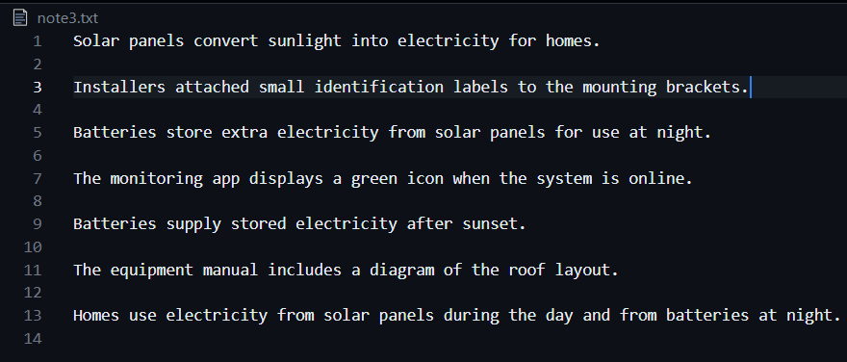
Demonstration
Notes:
Overall System Architecture
Target users
Students, researchers, Privacy-conscious note takers
Tools to be used
Language C++, Terminal, VS Codes, Git/Github

Slide 7
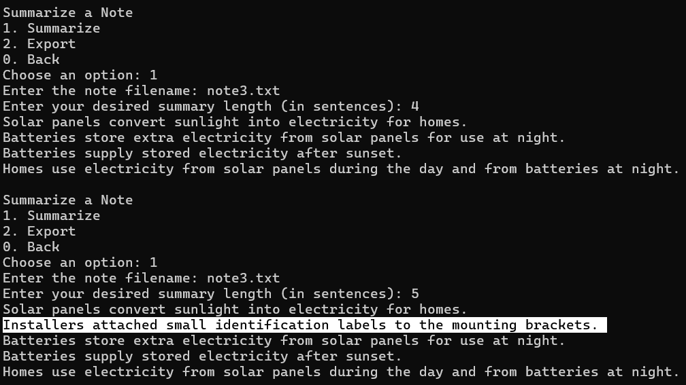
Demonstration
Notes:
Overall System Architecture
Target users
Students, researchers, Privacy-conscious note takers
Tools to be used
Language C++, Terminal, VS Codes, Git/Github

Slide 8
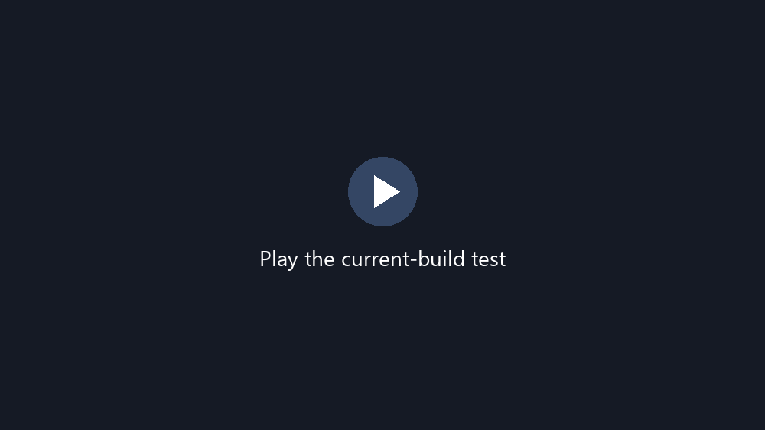
Demonstration
Notes:
Overall System Architecture
Target users
Students, researchers, Privacy-conscious note takers
Tools to be used
Language C++, Terminal, VS Codes, Git/Github

